Slide 1

Krishna Annugula
Cyber Security IT00DV52-3001
Data Protection, Laws and Cybersecurity
8 Dec 2020

Slide 2
Content
Data protection, Laws and Cybersecurity
Data Protection
Data Protection
Laws
Cybersecurity,
Importance of cybersecurity.
general categories in Cyber security
Analysis of Data Breaches and Cyber-Attacks
Regulatory Compliance & Advice
Why Combine Data protection and Cybersecurity

Slide 3
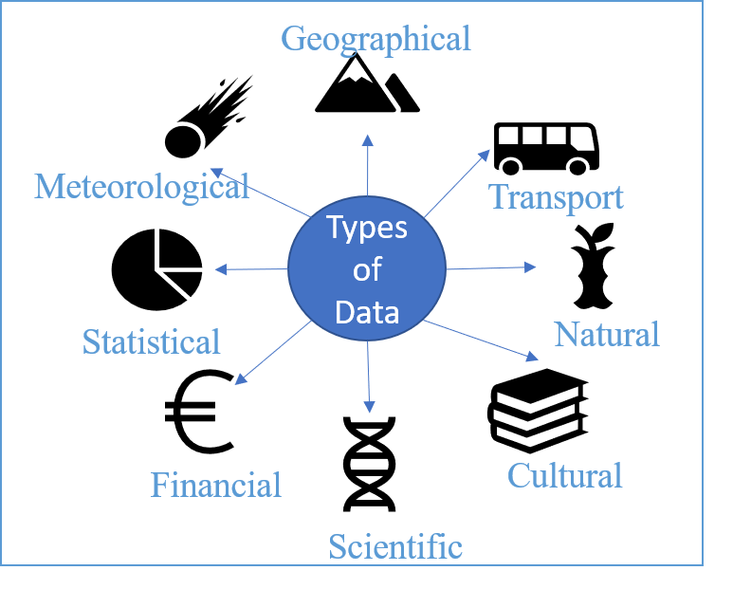
Data Protection
Data, Data Protection
Simply put, the data means, The key pieces of information that businesses typically store, whether it's employee records, customer information, health records, loyalty schemes, financial transactions, etc.
Data is collected in various ways on emails, telephones, interviews, lucky coupons, loyalty programs, survey questionnaires, health records, etc.
The common type of data stored by data brokers are Name, Email, Contact Information, Banking Information, Credit Information, Health Information, IP Address, Vehicle Registration Number, etc.
The Data visualized on the computer are Geographical, Transport, Natural, Meteorological, Statistical, Financial, Scientific and Cultural
One of the surveys stated that the data was collected and that they created a profile and sold it for advertising. A profile may add up to 1,500 points. There are many false and malicious web sites collecting a lot of data.
The importance of data protection grows with the volume of data created and stored. Data must be protected to prevent misuse of data by third parties for scams, such as identity theft and phishing.
Source:- João Batista Neto. Arquivo para a página [Internet]. 15 March 2013.

Slide 4
Data Protection Laws
laws
It is almost forty years since Sweden’s Data Act 1973 was the first comprehensive national data privacy law and was the first to implement.
The Data Protection Act (DPA) is a United Kingdom Act of Parliament which was passed in 1988
The Data Protection Act is a key law within the UK. Failure to comply can have serious consequences. These can include fines of anything up to £500,000 or action being taken that could result in a prison sentence.
More than 89 independent countries and territories, including almost all European countries and many Latin American and Caribbean countries, Asia and Africa, have now passed comprehensive data protection laws.
The European Union has the General Data Protection Regulation (GDPR). The GDPR was adopted on 14 April 2016 and became enforceable beginning 25 May 2018.

Slide 5
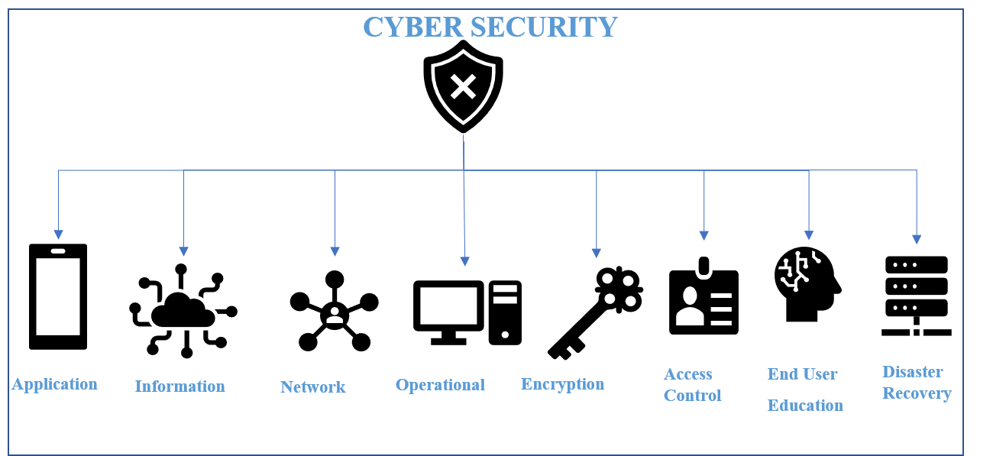
Cybersecurity
Cybersecurity
The term cybersecurity is disputed. its definition can vary even from one department to the another. There are over 400 cyber-related definitions, this is illustrated by The New America foundation study in 2014.
October is a national cyber security month, an annual awareness campaign on the importance of cyber security
Why Cyber security is important
Cybercrime is on high rise
There are approximately 4,000 cyber-attacks every day. The reason behind the rise of cybercrimes is that it is less expensive, faster and more cost-effective compared to other types of crimes.
Damage is significant
Cybercrime can cost the organization millions of euros in loss.
Cybersecurity builds trust
Cyber security flaws impacts the trust of clients and employees.
Protect our identities
Securing the identities will reduce the risk of cybercrime for the organization and individuals.
Every organization has vulnerabilities
Source:- Digital Defense Inc[Internet]. What is Cybersecurity & What Does it Really Mean?. 09 May 09 2018..

Slide 6
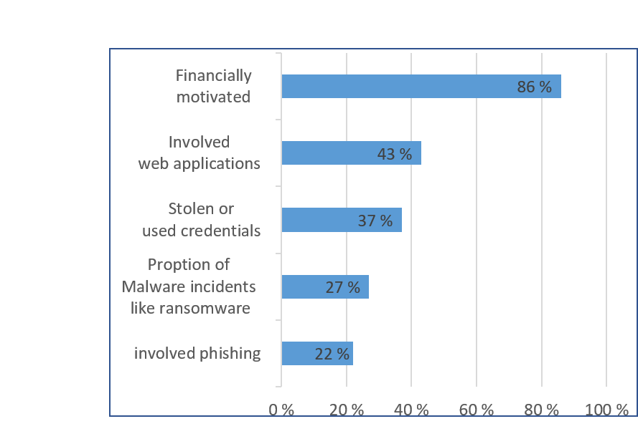
Data Breaches
Data Breaches
One of the research covered 50 medium-sized personal data breach cases with a damage scale of more than 1,000 cases and less than a million cases caused by unauthorized access and uploading photos on social media.
Mainly eight industries effected by this data breaches those are manufacturers, retail, services and infrastructure, software and telecommunications, trading companies, financial services, advertising/publishing/media, and government/public offices/organizations.
The major common features of data breaches are Financially motivated (86%), Involved web applications (43%), Stolen or used credentials (37%), Malware incidents like ransomware (27%) and involved phishing (22%).
There are 15 biggest data breaches of the 21st century.
Vastaamo (Finnish psychotherapy center) was one of the biggest criminal investigation in Finland based on number of victims its around 40000 people’s data. Hackers demanded around 450,000 euros in exchange.
Source:- Data Breach Investigations Report(DBIR). Verizon. July 2020..

Slide 7
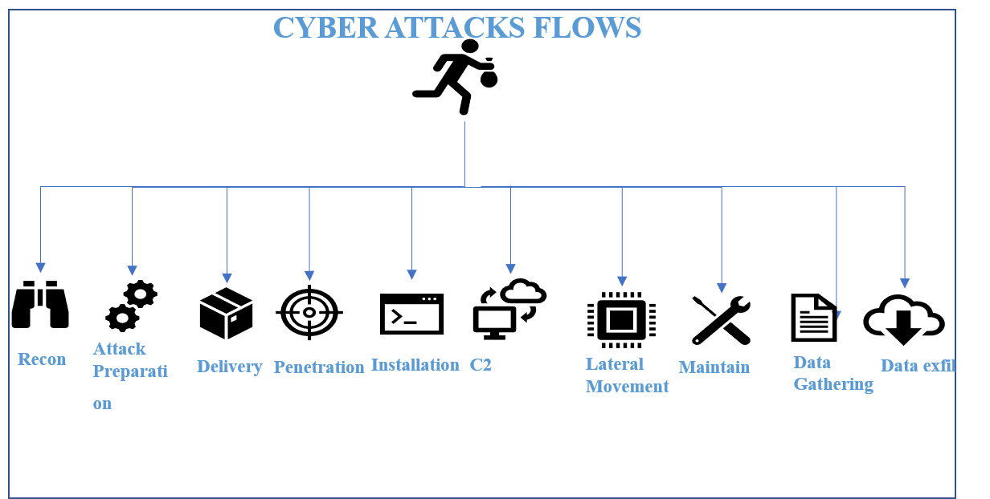
Cyber Attacks
Cyber Attacks
There are 9 key cybersecurity statistics at-a-glance.
$17,700 is wasted every minute on phishing attacks
94% of malicious software is delivered through email
40% of IT leaders report that cybersecurity positions are the most challenging to fill
60% of the breaches were related to vulnerabilities where a fix was available but not implemented
Phishing attacks make up over 80% of reported security incidents
63% of businesses said their data was potentially compromised in the past 12 months due to a hardware or silicon security vulnerability
Data breaches average $3.92 million for companies
File-less attacks increased 256% in H1 2019.
Attacks against IoT devices tripled in H1 2019.
Cyber-attacks are performed in phases
Information gathering.
Weaponization.
Exploitation.
Persistence.
C2(Command and Control).
Actions on objective.
Source:- Tommi Vihermaa. Trends in ICT, nixu cybersecurity[unpublished lecture notes]. Nov 09, 2020.

Slide 8
Regulatory Compliance & Advice
To overcome these data violations and cyber attacks, every individual and every organization must follow certain rules
Regulatory Compliance for corporate safety
Policies Management
Cybersecurity advice for a secure organization
Assess current security status
Continuously maintain and improve security posture
Keep an eye on information security incidents
Prepare by practicing
Maintain security expertise
Data protection guidance for information security
Use strong encryption.
Priorities staff training.
Minimize data use.
Store data no longer than necessary.
Ensure crisis resilience.
Manage passwords properly.
Invest in a visitor management solution.
Security Regulations
Rules
Standards
Adhering to Law

Slide 9
Conclusion
Why Combine Cybersecurity and Data Protection?
Prevent data breaches. Overseeing both data and systems at the same time leaves less space for vulnerabilities and exploits.
Address emerging digital threats. There are digital threats that pose a risk for both data and systems.
Enhance your information security management system. Having a single pane of glass ISMS allows you to control your data better than with separate infrastructure for data protection and cybersecurity.
Improve compliance. Reducing the probability of a data breach helps you to stay compliant and avoid compliance violation penalties.
Both data protection and cybersecurity deal with protecting sensitive data from various digital threats. That’s why they have become interconnected. Rather than having them respond to a breach separately, it makes sense to have one integrated approach.
If the target looks too difficult to breach, attackers will choose an easier target.
Here is need of combining Data Protection and Cyber Security
Source:- Dmitry Dontov, Why Data Protection And Cybersecurity Can't Be Separate Functions,YECCOUNCIL POST[Internet].Nov 25, 2020

Slide 10

Discussions

